Slide 1

THE
FORE RUNNERS
Believe and everything is possible

Slide 2
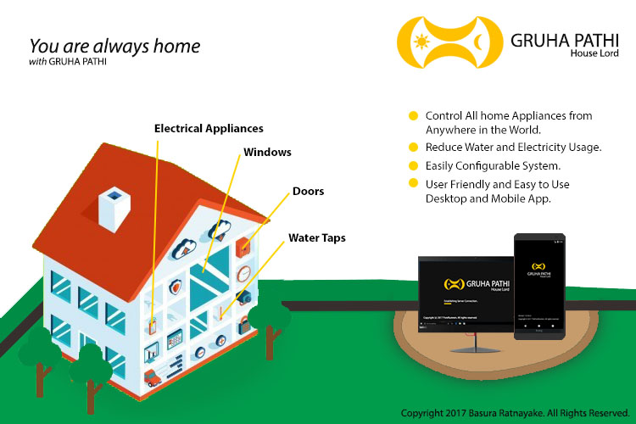

Slide 3
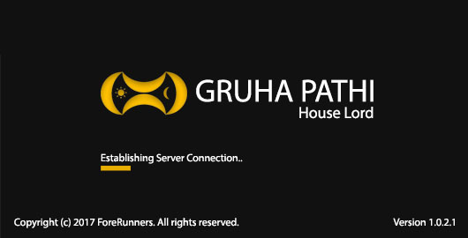
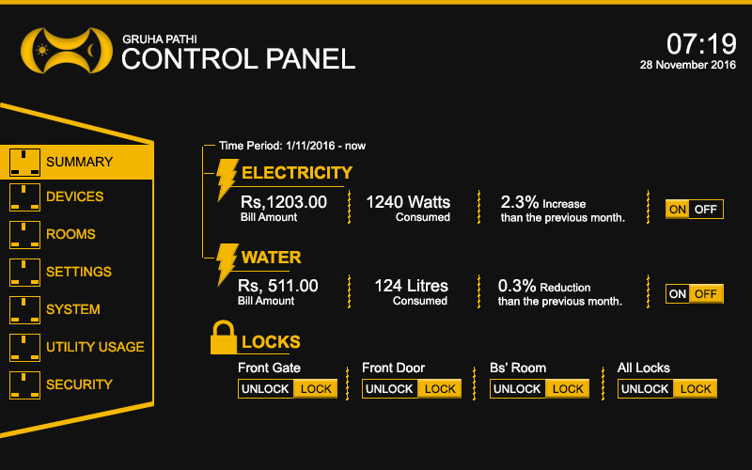
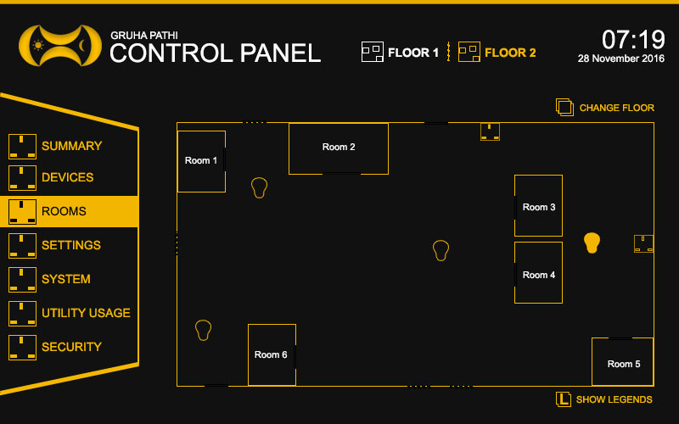
DESKTOP APPLICATION
Free and Easy to Use.
Control Your House From Anywhere in the world.
View Device Consumption Details.
No Configuration Required.
Build Your House Floor Layout.
Full Control Of Your House.

Slide 4
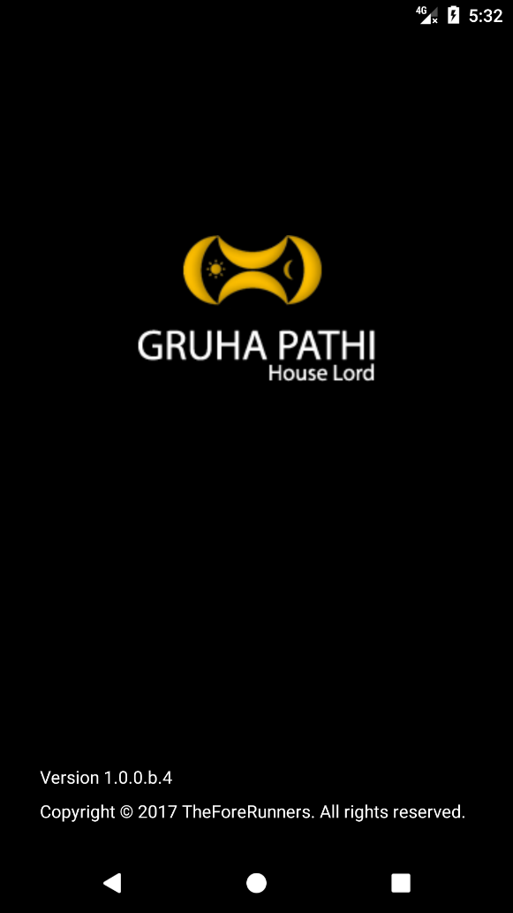
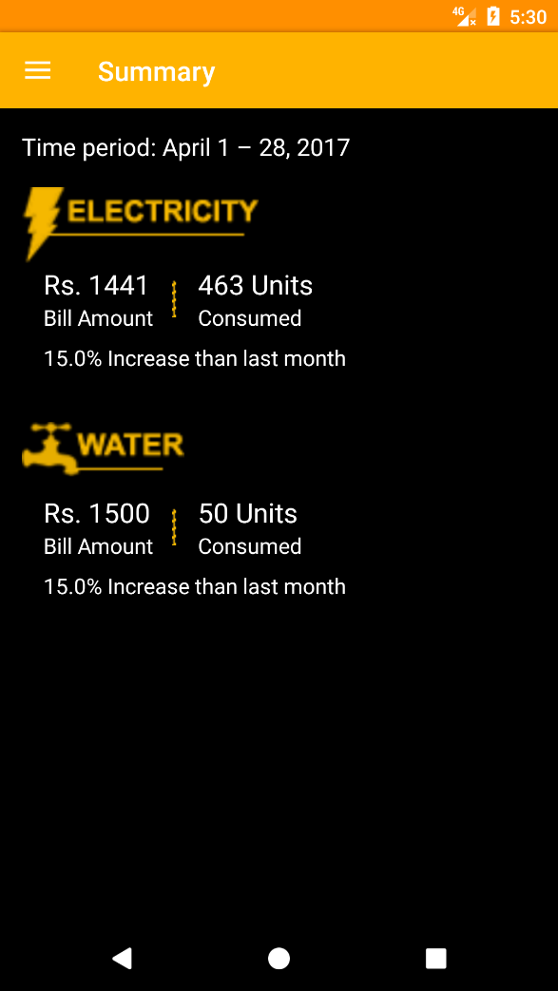
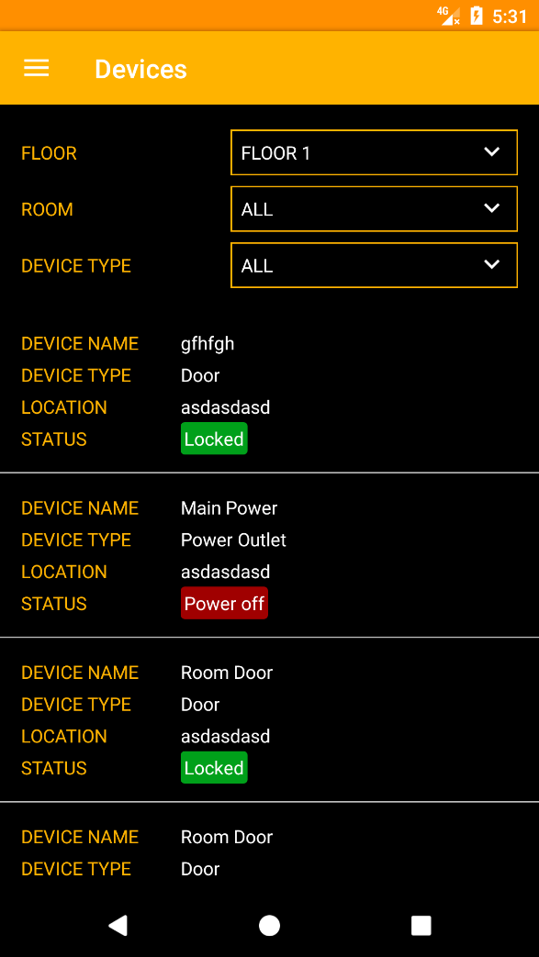
SMARTPHONE APPLICATION
Free and Easy to Use.
Control Your House From Anywhere in the world.
View Device Consumption Details.
No Configuration Required.

Slide 5


Slide 6
OUR SMART DEVICES
Use 230V AC House Power.
Less Power Consumption.
User Friendly Design.
Use 433 MHz Frequency Instead of wasting the internet bandwidth.
Configuration Less Plug and Play Devices.
Respond to Mobile and Desktop Application.
Store Consumption Details.
Sizable Without Limit.

Slide 7
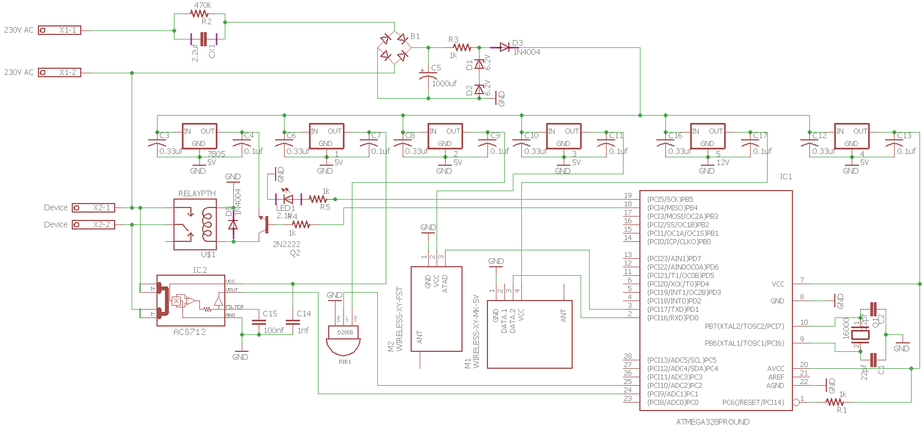

Slide 8
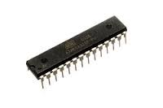
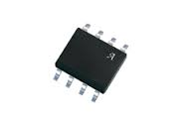
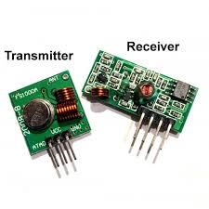
Micro-Controller IC
Voltage Measure IC
Flash:32 kBytes
Pin Count:32
Max. Operating Freq. (MHz):20 MHz
CPU:8-bit AVR
Max I/O Pins:23
Input Voltage: 5V
Measure Voltage: 230V 30A
Bandwidth: 80 kHz
Transmitter
Frequency Range: 433.92MHz
Input Voltage: 3-12V
Transmission Range: 7cm but with 17cm Antenna 700m
Receiver
Frequency Range: 433.92 MHz
Modulation: ASK
Input Voltage: 5V

Slide 9
SMART HUB
SMART DOOR
SMART LIGHT
SMART SOCKET
SMART WATER VALVE
.
.
.
Many More Possibilities…

Slide 10
THANK YOU

